Slide 1
Deep Reinforcement Learning

Slide 2
What is Deep Reinforcement Learning (DRL)?
Deep Reinforcement Learning (DRL), a very fast-moving field, is the combination of Reinforcement Learning and Deep Learning.
It is also the most trending type of Machine Learning because it can solve a wide range of complex decision-making tasks that were previously out of reach for a machine to solve real-world problems with human-like intelligence.
Deep Reinforcement Learning is one of the most exciting fields in Artificial Intelligence. It’s about the power and the ability of deep neural networks to represent and comprehend the world with the ability to act on that understanding.

Slide 3
Introduction and Background
Exciting news in Artificial Intelligence (AI) has just happened in recent years.
Example:
1.AlphaGo defeated the best professional human player in the game of Go. 2.Oriol Vinyals and his team in DeepMind showed the AlphaStar Agent beat professional players at the game of StarCraft II.
3.OpenAI’s Dota-2-playing bot became the first AI system to beat the world champions in an e-sports game.
All these systems have in common that they use Deep Reinforcement Learning (DRL).
But what are AI and DRL?

Slide 4
Artificial Intelligence
Artificial Intelligence, the main field of computer science in which Reinforcement Learning (RL) falls into, is a discipline concerned with creating computer programs that display humanlike “intelligence”.
Artificial Intelligence has grown to be very popular in today’s world. It is the simulation of natural intelligence in machines that are programmed to learn and mimic the actions of humans.
These machines are able to learn with experience and perform human-like tasks. As technologies such as AI continue to grow, they will have a great impact on our quality of life.
It’s but natural that everyone today wants to connect with AI technology somehow, may it be as an end-user or pursuing a career in Artificial Intelligence.

Slide 5
Machine Learning
Machine Learning could be defined as the subfield of Artificial Intelligence that gives computers the ability to learn without being explicitly programmed, that is, without requiring the programmer to indicate the rules that must be followed to achieve their task; the computers do them automatically.
Machine Learning consists of developing a prediction “algorithm” for a particular use case for each problem. These algorithms learn from the data to find patterns or trends to understand what the data tell us, and in this way, build a model to predict and classify the elements.
There are many well-established approaches to Machine Learning. Each of them uses a different algorithmic structure to optimize the predictions based on the received data.

Slide 6
Machine Learning
Machine Learning is a broad field with a complex taxonomy of algorithms that are grouped, in general, into three main categories:
1.Supervised Learning is the task of learning from tagged data, and its goal is to generalize. learning is supervised when the data we use for training includes the desired solution, called “label”. Some of the most popular machine learning algorithms in this category are linear regression, logistic regression, support vector machines, decision trees, random forest, or neural networks.

Slide 7
Machine Learning
2.Unsupervised Learning is the task of learning from unlabeled data, and its goal is to compress. When the training data do not include the labels, we refer to Unsupervised Learning, and it will be the algorithm that will try to classify the information by itself. Some of the best-known algorithms in this category are clustering (K-means) or principal component analysis (PCA).
3. Reinforcement Learning is the task of learning through trial and error and its goal is to act. This learning category allows it to be combined with other categories, and it is now a very active research area.

Slide 8
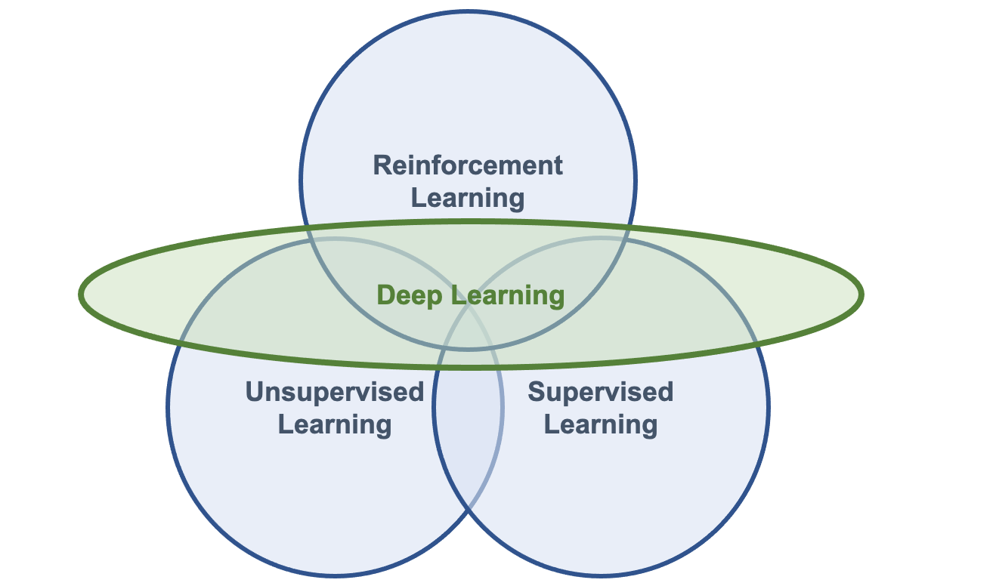
Deep Learning
Deep Learning algorithms are based on artificial neural networks, whose algorithmic structures allow models composed of multiple processing layers to learn data representations with various abstraction levels.
DL is a collection of techniques and methods for using neural networks to solve ML tasks, either Supervised Learning, Unsupervised Learning, or Reinforcement Learning

Slide 9
Deep Reinforcement Learning
One of the most intriguing areas of artificial intelligence today is the concept of deep reinforcement learning, where machines can teach themselves based upon the results of their own actions
Deep reinforcement learning is a category of machine learning and artificial intelligence where intelligent machines can learn from their actions similar to the way humans learn from experience.
Inherent in this type of machine learning is that an agent is rewarded or penalised based on their actions. Actions that get them to the target outcome are rewarded (reinforced).

Slide 10
Deep Reinforcement Learning
Through a series of trial and error, a machine keeps learning, making this technology ideal for dynamic environments that keep changing. Although reinforcement learning has been around for decades, it was much more recently combined with deep learning, which yielded phenomenal results.
The "deep" portion of reinforcement learning refers to a multiple (deep) layers of artificial neural networks that replicate the structure of a human brain. Deep learning requires large amounts of training data and significant computing power.
Over the last few years, the volumes of data have exploded while the costs for computing power have dramatically reduced, which has enabled the explosion of deep learning applications.

Slide 11
Learning by interacting
Learning by interacting with our Environment is probably the first approach that comes to our mind when we think about the nature of learning.
It is the way we feel that an infant learns. And we know that such interactions are undoubtedly an essential source of knowledge about our environment and ourselves throughout people’s lives, not just infants.
For example, when we are learning to drive a car, we are entirely aware of how the environment responds to what we do, and we also seek to influence what happens in our environment through our actions.
Learning from the interaction is a fundamental concept that underlies almost all learning theories and is the foundation of Reinforcement Learning.

Slide 12
Learning by interacting
The approach of Reinforcement Learning is much more focused on goal-directed learning from interaction than are other approaches to Machine Learning.
The learning entity is not told what actions to take, but instead must discover for itself which actions produce the greatest reward, its goal, by testing them by “trial and error.”
Furthermore, these actions can affect not only the immediate reward but also the future ones, “delayed rewards”, since the current actions will determine future situations (how it happens in real life).
These two characteristics, “trial and error” search and “delayed reward”, are two distinguishing characteristics of reinforcement learning.

Slide 13
Key elements of Reinforcement Learning
Agent and Environment
State
Observation
Action and the Transition function
Reward

Slide 14
Agent and Environment
In Reinforcement Learning there are two core components:
An Agent, that represents the “solution” , which is a computer program with a single role of making decisions (actions) to solve complex decision-making problems under uncertainty.
An Environment, that is the representation of a “problem”, which is everything that comes after the decision of the Agent. The environment responds with the consequences of those actions, which are observations or states, and rewards, also sometimes called costs.
For example, tic-tac-toe game - Agent → one of the players
Environment → board game and the other player.
These two core components continuously interact so that the Agent attempts to influence the Environment through actions, and the Environment reacts to the Agent’s actions.

Slide 15
State
The Environment is represented by a set of variables related to the problem (very dependent on the type of problem we want to solve).
This set of variables and all the possible values they can take are referred to as the state space.
A state is an instantiation of the state space, a set of values the variables take.

Slide 16
Observation
Due that we are considering that the Agent doesn’t have access to the actual full state of the Environment, it is usually called observation, the part of the state that the Agent can observe.

Slide 17
Action and the Transition function
At each state, the Environment makes available a set of actions, from which the Agent will choose an action.
The Agent influences the Environment through these actions, and the Environment may change states as a response to the Agent’s action.
The function responsible for this mapping is called in the literature transition function or transition probabilities between states.

Slide 18
Reward
The Environment commonly has a well-defined task and may provide to the Agent a reward signal as a direct answer to the Agent’s actions.
This reward is feedback on how well the last action contributes to achieving the task to be performed by the Environment.
The function responsible for this mapping is called the reward function. As we will see later, the Agent’s goal is to maximize the overall reward it receives, and so rewards are the motivation the Agent needs to act in the desired behavior.

Slide 19
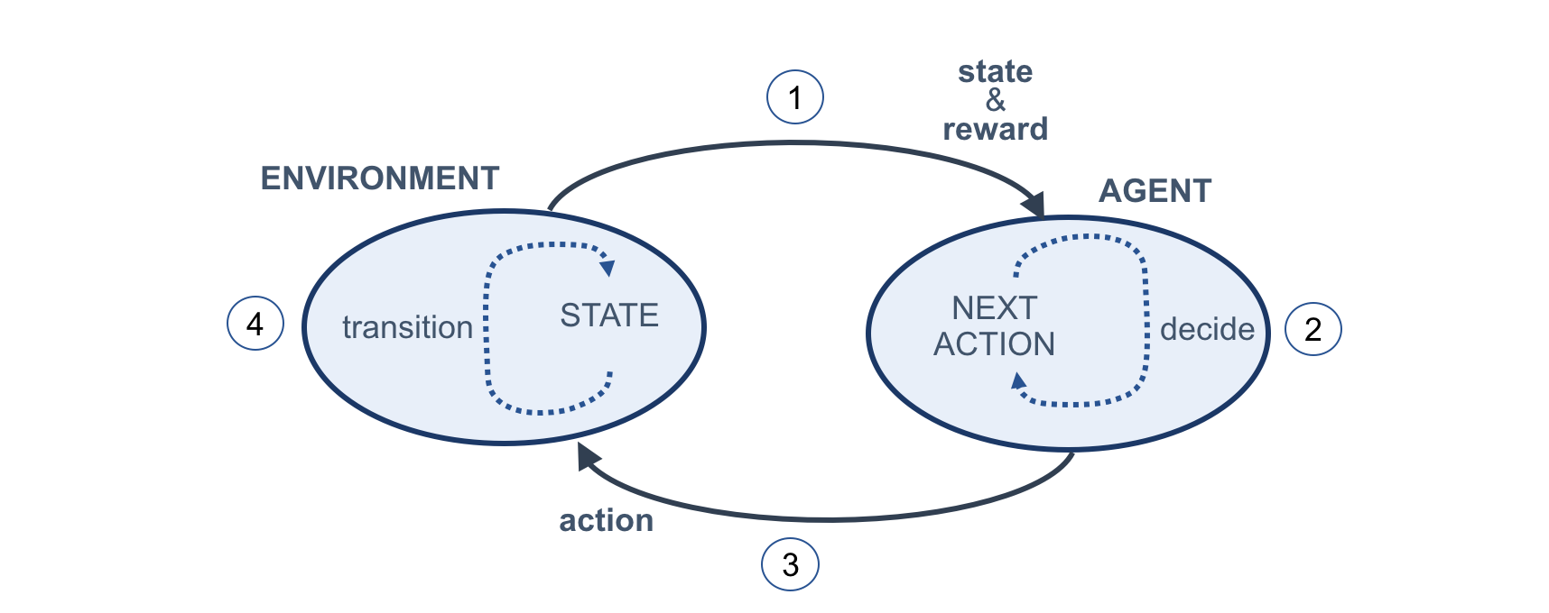
Reinforcement Learning cycle
Reinforcement Learning is basically about turning this Figure into a mathematical formalism.
The cycle begins with the Agent observing the Environment (step 1) and receiving a state and a reward. The Agent uses this state and reward for deciding the next action to take (step 2). The Agent then sends an action to the Environment in an attempt to control it in a favorable way (step 3).
Finally, the environment transitions, and its internal state changes as a consequence due to the previous state and the Agent’s action (step 4). Then, the cycle repeats.

Slide 20
Episode
The task the Agent is trying to solve may or may not have a natural ending. Tasks that have a natural ending, such as a game, are called episodic tasks.
Conversely, tasks that do not, are called continuous tasks, for example learning forward motion.
The sequence of time steps from the beginning to the end of an episodic task is called an episode.

Slide 21
Return
Agents may take several time steps and episodes to learn how to solve a task. The sum of rewards collected in a single episode is called a return. Agents are often designed to maximize the return.
One of the limitations is that these rewards are not disclosed to the Agent until the end of an episode, which we introduced earlier as “delayed reward”.
For example, in the game of tic-tac-toe the rewards for each movement (action) are not known until the end of the game. It would be a positive reward if the agent won the game (because the agent had achieved the overall desired outcome) or a negative reward (penalties) if the agent had lost the game.

Slide 22
Exploration vs. Exploitation
Another important characteristic, and challenge in Reinforcement Learning, is the trade-off between “exploration” and “exploitation”.
Trying to obtain many rewards, an Agent must prefer actions that it has tried in the past and knows that will be effective actions in producing reward.
But to discover such actions, paradoxically, it has to try actions that it has not selected never before.
An Agent has to exploit what it has already experienced to obtain as much reward as possible, but at the same time, it also has to explore to make select better action in the future.

Slide 23
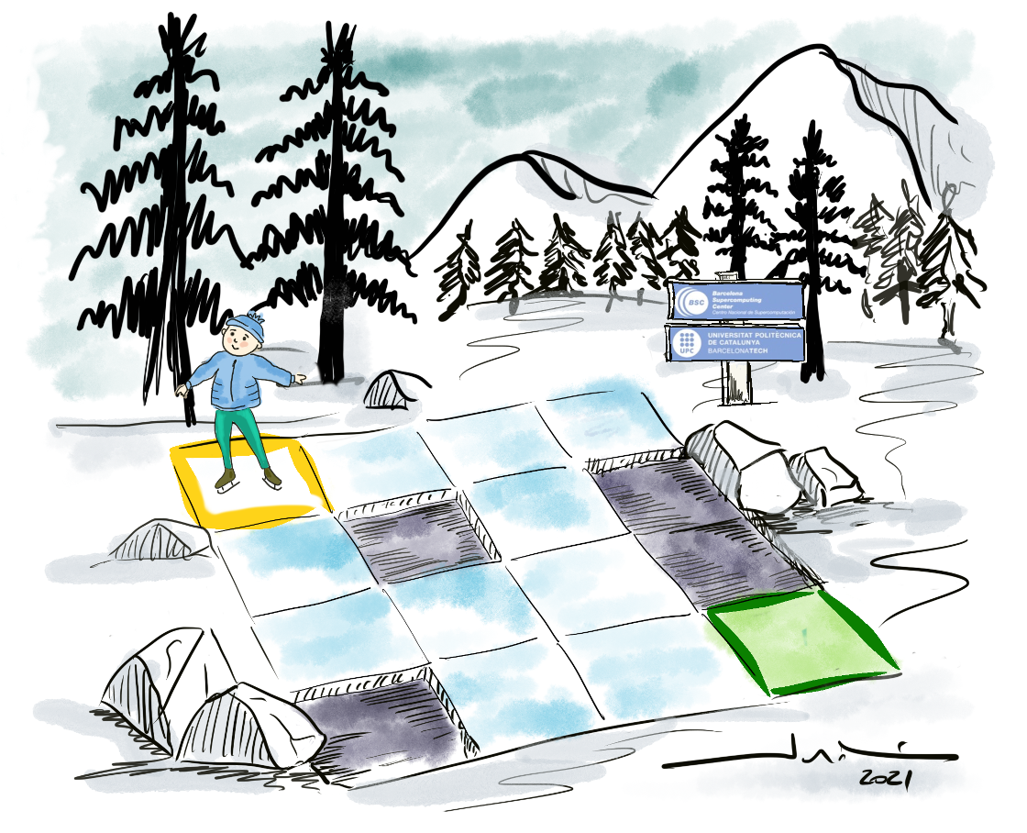
The Frozen-Lake example
Frozen Lake (very slippery) where our agent can skate.
The Frozen-Lake Environment that we will use as an example is an ice skating rink, divided into 16 cells (4x4), and as shown in the figure below, some of the cells have broken the ice.
The skater named Agent begins to skate in the top-left position, and its goal is to reach the bottom-right place avoiding falling into the four holes in the track.

Slide 24
Gym Toolkit
OpenAI is an artificial intelligence (AI) research organization that provides a famous toolkit called Gym for training a reinforcement learning agent to develop and compare RL algorithms.
Gym offers a variety of environments for training an RL agent ranging from classic control tasks to Atari game environments. We can train our RL agent to learn in these simulated environments using various RL algorithms.
we will use the Gym toolkit to build and evaluate reinforcement learning algorithms for several classic control tasks such as Cart-Pole balancing or mountain car climbing.

Slide 25
Gym Toolkit
Gym also provides 59 Atari game environments, including Pong, Space Invaders, Air Raid, Asteroids, Centipede, Ms. Pac-Man, etc.
Training our reinforcement learning agent to play Atari games is an interesting as well as challenging task.
Later we will train our DQN reinforcement learning agent to play Atari Pong game environment.

Slide 26
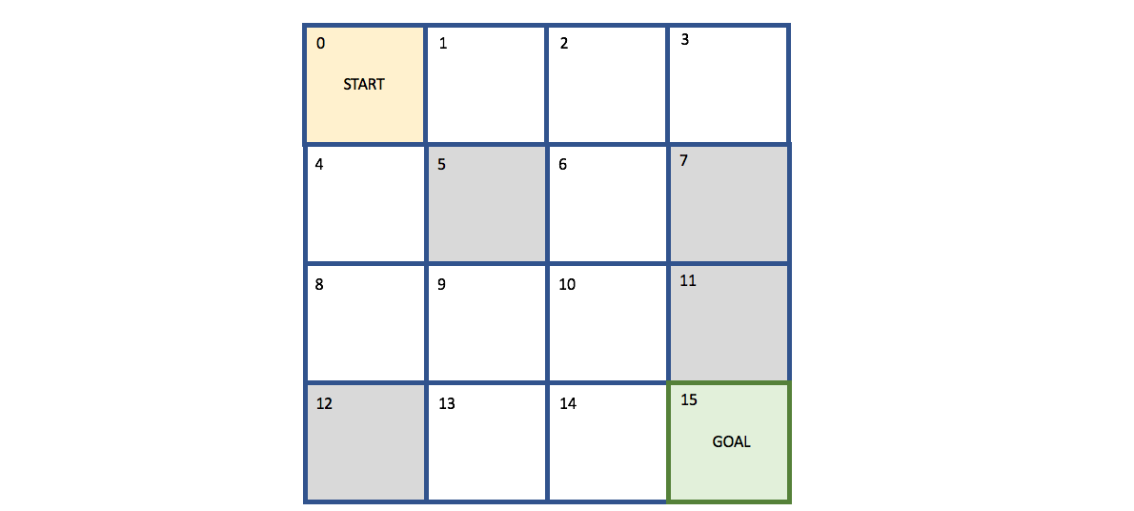
The Frozen-Lake Environment
Frozen-Lake Environment is from the so-called grid-world category when the Agent lives in a grid of size 4x4 (has 16 cells), which means a state space composed of 16 states (0–15) in the i, j coordinates of the grid-world.
In Frozen-Lake, the Agent always starts at a top-left position, and its goal is to reach the bottom-right position of the grid.
There are four holes in the fixed cells of the grid, and if the Agent gets into those holes, the episode ends, and the reward obtained is zero. If the Agent reaches the destination cell, it receives a reward of +1, and the episode ends.

Slide 27
The Frozen-Lake Environment
To reach the goal, the Agent has an action space composed of four directions movements: up, down, left, and right. We also know that there is a fence around the lake, so if the Agent tries to move out of the grid world, it will just bounce back to the cell from which it tried to move.
Because the lake is frozen, the world is slippery, so the Agent’s actions do not always turn out as expected — there is a 33% chance that it will slip to the right or the left. If we want the Agent to move left, for example, there is a 33% probability that it will, indeed, move left, a 33% chance that it will end up in the cell above, and a 33% chance that it will end up in the cell below.

Slide 28
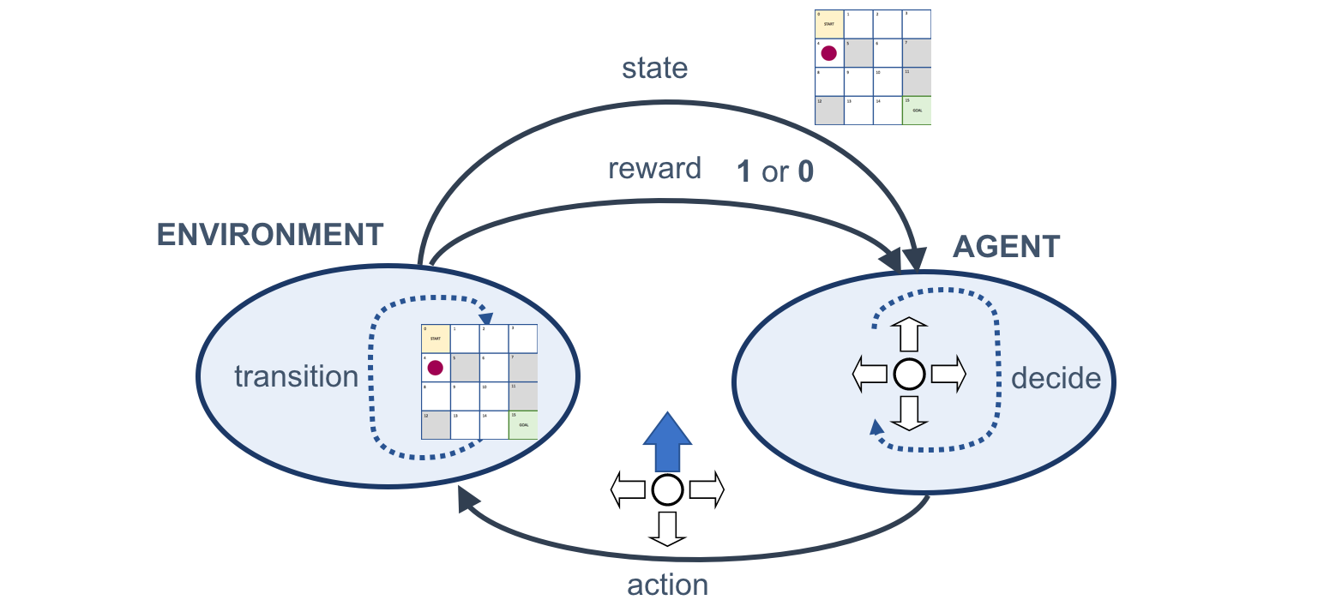
Schematic representation of the Reinforcement Learning cycle for the Frozen-Lake example.

Slide 29
Coding the Environment
use the Colab offered by Google to execute the code described in this post (Gym package is already installed). If you prefer to use your Python programming environment, you can install Gym using the steps provided here.
The first step is to import Gym:
import gym
Then, specify the game from Gym you want to use. We will use the Frozen-Lake game:
env = gym.make('FrozenLake-v0')
The environment of the game can be reset to the initial state using:
env.reset()
And, to see a view of the game state, we can use:
env.render()

Slide 30

Coding the Environment
The surface rendered by render()is presented using a grid like the following figure:
Where the highlighted character indicates the position of the Agent in the current time step and
“S” indicates the starting cell (safe position)
“F” indicates a frozen surface (safe position)
“H” indicates a hole
“G”: indicates the goal

Slide 31
Coding the Agent
For the moment, we will create the most straightforward Agent that we can make that only does random actions. For this purpose, we will use the action_space.sample() that samples a random action from the action space.
Assume that we allow a maximum of 10 iterations; the following code can be our “dumb” Agent:

Slide 32
import gym
env = gym.make("FrozenLake-v0")
env.reset()
for t in range(10):
print("\nTimestep {}".format(t))
env.render()
a = env.action_space.sample()
ob, r, done, _ = env.step(a)
if done:
print("\nEpisode terminated early")
break
Coding the Agent

Slide 33
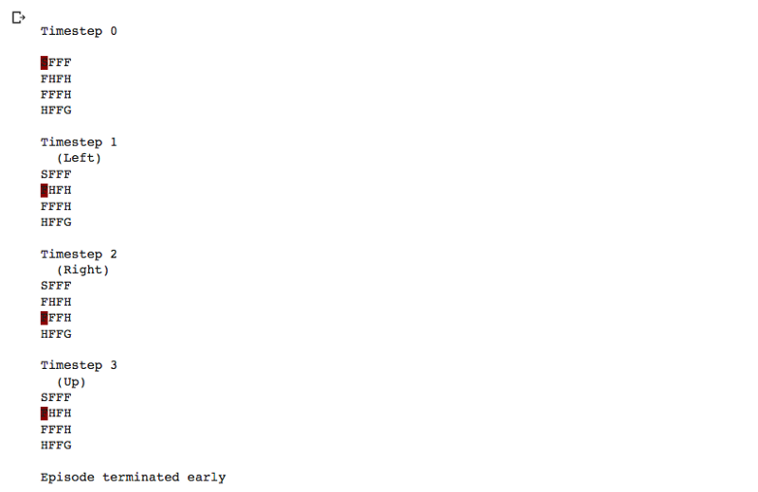
If we run this code, it will output something like the following lines, where we can observe the Timestep, the action, and the Environment state:

Slide 34
RL Agent-Environment
A reinforcement learning task is about training an agent which interacts with its environment.
The agent arrives at different scenarios known as states by performing actions.
Actions lead to rewards which could be positive and negative.
The agent has only one purpose here – to maximize its total reward across an episode. This episode is anything and everything that happens between the first state and the last or terminal state within the environment.
We reinforce the agent to learn to perform the best actions by experience. This is the strategy or policy.

Slide 35
Ex:PubG Game
Let’s take an example of the ultra-popular PubG game:
The soldier is the agent here interacting with the environment
The states are exactly what we see on the screen
An episode is a complete game
The actions are moving forward, backward, left, right, jump, duck, shoot, etc.
Rewards are defined on the basis of the outcome of these actions. If the soldier is able to kill an enemy, that calls for a positive reward while getting shot by an enemy is a negative reward
Now, in order to kill that enemy or get a positive reward, there is a sequence of actions required. This is where the concept of delayed or postponed reward comes into play. The crux of RL is learning to perform these sequences and maximizing the reward.

Slide 36
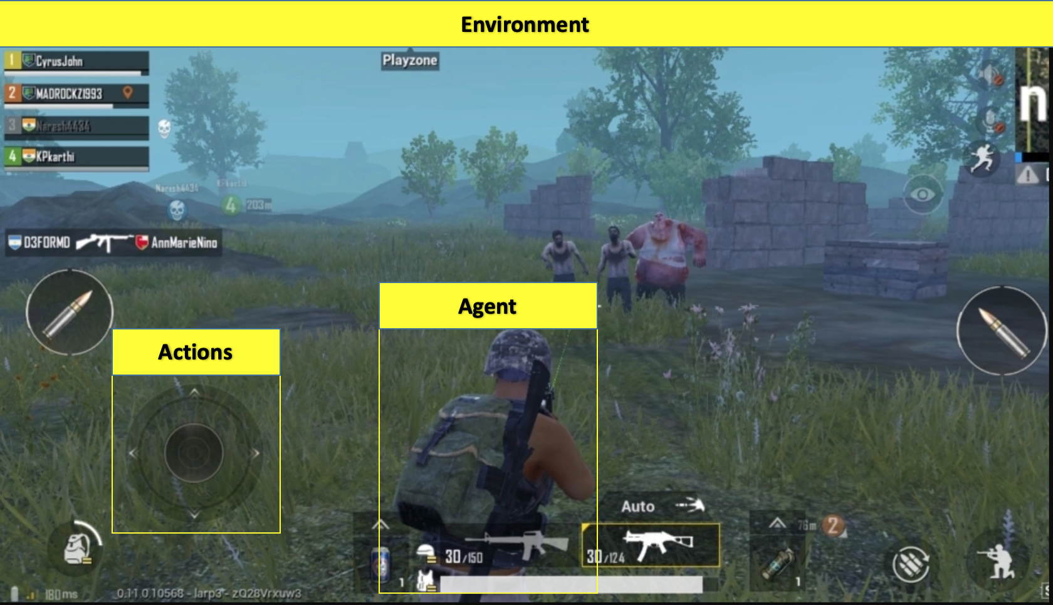

Slide 37
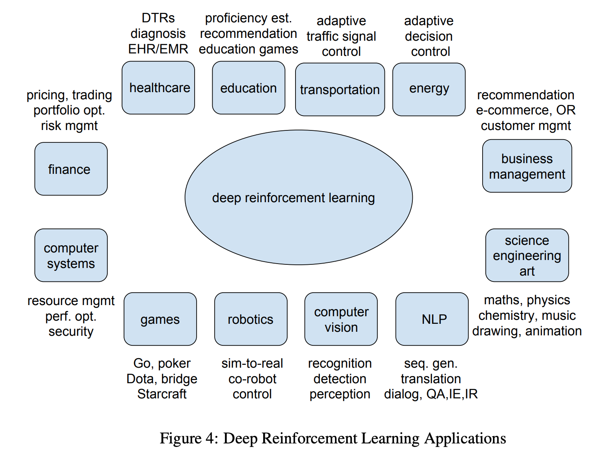

Slide 38
Useful links
https://gym.openai.com/envs/FrozenLake-v0/
https://paperswithcode.com/task/atari-games

Slide 39
Deep Reinforcement Learning Masters Atari Games

Slide 40
why is playing Atari with deep reinforcement learning a deal at all?
Reinforcement learning is based on a system of rewards and punishments (reinforcements) for a machine that gets a problem to solve.
It is a cutting-edge technology that forces the AI model to be creative – it is provided only with the indicator of success and no additional hints.
Experiments combining deep learning and reinforcement learning have been done in particular by DeepMind (in 2013) and by Gerald Tesauro even before (in 1992).
We focused on reducing the time needed to train the model.

Slide 41
why is playing Atari with deep reinforcement learning
A well-designed system of rewards is essential in human education.
Now, with reinforcement learning, such a system has become a pillar of teaching computers to perform more sophisticated tasks, such as beating human champions in the game Go.
In the near future it may be driving an autonomous car. In the case of the Atari 2600 game, the only indicator of success was the points the artificial intelligence earned.
There were no further hints or suggestions. Thus the algorithm had to learn the rules of the game and find the most effective tactics by itself to maximize the long-term rewards it earned.

Slide 42
why is playing Atari with deep reinforcement learning
In 2013 the learning algorithm needed a whole week of uninterrupted training in an arcade learning environment to reach superhuman levels in classics like Breakout (knocking out a wall of colorful bricks with a ball) or Space Invaders (shooting out alien invaders with a mobile laser cannon).
By 2016 DeepMind had cut the time to 24 hours by improving the algorithm.

Slide 43
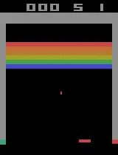
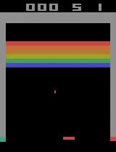
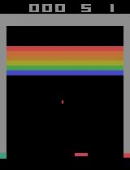
Breakout
Initial performance | After 15 minutes of training | After 30 minutes of training

Slide 44
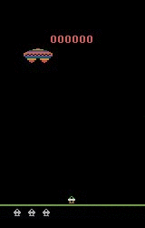
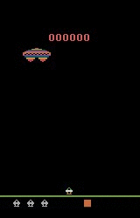
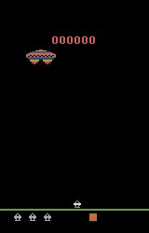
Assault
Initial performance | After 15 minutes of training | After 30 minutes of training

Slide 45
Cutting the time of deep reinforcement learning
DeepMind’s work inspired various implementations and modifications of the base algorithm including high-quality open-source implementations of reinforcement learning algorithms presented in Tensorpack and Baselines. In our work we used Tensorpack.
The reinforcement learning agent learns only from visual input, and has access to only the same information given to human players. From a single image the RL agent can learn about the current positions of game objects, but by combining the current image with a few that preceded it, the deep neural network is able to learn not only positions, but also the game’s physical characteristics, such as speed at which objects are moving.

Slide 46
Cutting the time of deep reinforcement learning
The results of the parallelization experiment conducted by deepesense.ai were impressive – the algorithm required only 20 minutes to master Atari video games, a vast improvement over the approximately one week required in the original experiments done by DeepMind.
We provided the code and technical details on arXiv, GitHub and in a blog post, so that others can easily recreate the results. Similar experiments optimizing the training time of Atari games have been conducted by Adam Stooke and Pieter Abbeel from UC Berkeley among others, including OpenAI and Uber.

Slide 47
why Atari games?
A typical Atari game provides an environment consisting of a single screen with a limited context and a relatively simple goal to achieve.
However, the number of variables which AI must consider is comparable to other visual training environments.
Achieving superhuman performance in Atari games is a good indicator that an algorithm will perform well in other tasks.
A robotic “game” may mean delivering a human to a destination point without incident or accident or reducing power usage in an intelligent building without any interruption to the business being conducted inside.
The huge potential of reinforcement learning is seen in robotics, an area deepsense.ai is continuously developing.

Slide 48
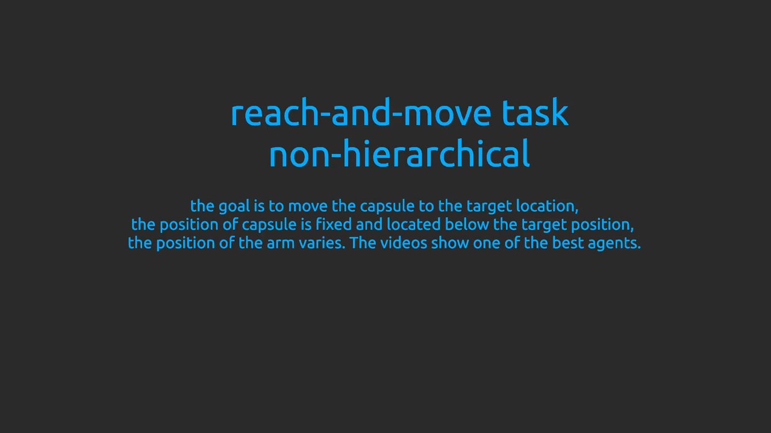

Slide 49
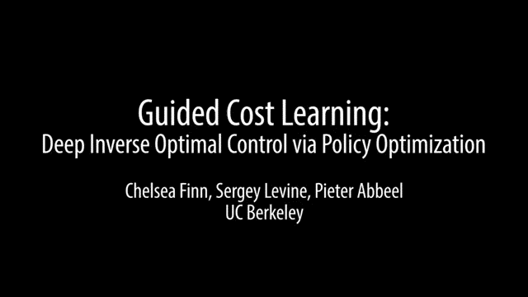

Slide 50
Robotic Arm
A robotic arm can be effectively programmed to perform repetitive tasks like putting in screws on an assembly line.
The task is always done in the same conditions, with no variables or unexpected events. But when empowered with reinforcement learning and computer vision, the arm will be able to find a bottle of milk in a refrigerator, a particular book on a bookshelf or a plate in a dryer.
The possibilities are practically endless. An interesting demonstration of reinforcement learning in robotics may be seen in the video

Slide 51
MDPs
The reinforcement learning is about solving Markov Decision Processes (MDPs).
An MDP is simply a formal way of describing a game using the concepts of states, actions and rewards.
Let’s explain what these are using Atari as an example:

Slide 52
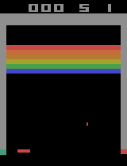
States
The state is the current situation that the agent (your program) is in. The simplest approximation of a state is simply the current frame in your Atari game. Unfortunately, this is not always sufficient: given the image on the left, you are probably unable to tell whether the ball is going up or going down
it actually matters a lot because such a state representation would break the Markov property of the MDP, namely that history doesn’t matter: there mustn’t be any useful information in previous states for the Markov property to be satisfied. In the case of using a single image as our state, we are breaking the Markov property because previous frames could be used to infer the speed and acceleration of the ball and paddle.
An inadequate representation of state

Slide 53
States
A simple trick to deal with this is simply to bring some of the previous history into your state (that is perfectly acceptable under the Markov property). DeepMind chose to use the past 4 frames, so we will do the same. 2 frames is necessary for our algorithm to learn about the speed of objects, 3 frames is necessary to infer acceleration. It is unclear to me how necessary the 4th frame is (to infer the 3rd derivative of position? to gain better precision?), perhaps this is something you can experiment with.

Slide 54
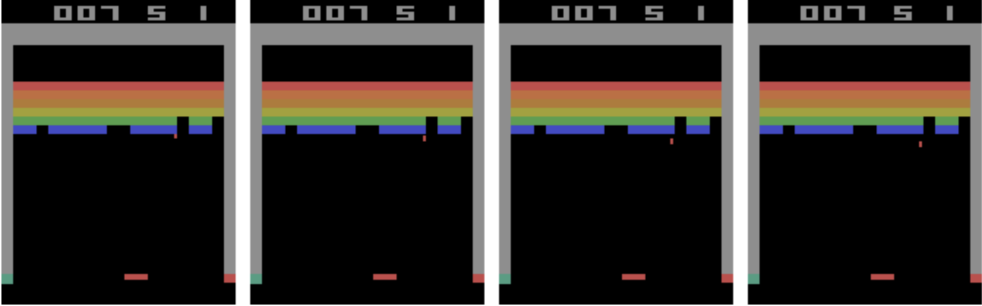
Data preparation
4 consecutive frames (single observation)

Slide 55
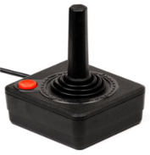
Actions
n action is a command that you can give in the game in the hope of reaching a certain state and reward (more on those later). In the case of Atari games, actions are all sent via the joystick.
A total of 18 actions can be performed with the joystick: doing nothing, pressing the action button, going in one of 8 directions (up, down, left and right as well as the 4 diagonals) and going in any of these directions while pressing the button. Of course, only a subset of these make sense in any given game (eg in Breakout, only 4 actions apply: doing nothing, “asking for a ball” at the beginning of the game by pressing the button and going either left or right).
The Atari joystick, through which human players send actions

Slide 56
Actions
It is worth noting that with Atari games, the number of possible states is much larger than the number of possible actions. This is quite fortunate because dealing with a large state space turns out to be much easier than dealing with a large action space.
In other words, it is perfectly possible that taking action 1 in state A will take you to state B 50% of the time and state C another 50% of the time. As it turns out this does not complicate the problem very much.

Slide 57
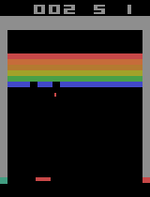
Rewards
The last component of our MDPs are the rewards. Rewards are given after performing an action, and are normally a function of your starting state, the action you performed, and your end state. The goal of your reinforcement learning program is to maximize long term rewards.
Score increases from 2 to 3, so we get +1 reward

Slide 58
Discounting
In practice, our reinforcement learning algorithms will never optimize for total rewards per se, instead, they will optimize for total discounted rewards. In other words, we will choose some number γ (gamma) where 0 < γ < 1, and at each step in the future, we optimize for r0 + γ r1 + γ² r2 + γ³ r3… (where r0 is the immediate reward, r1 the reward one step from now etc.).
with discounting, your sum of rewards is guaranteed to be finite, whereas without discounting it might be infinite. Infinite total rewards can create a bunch of weird issues: for example, how do you choose between an algorithm that gets +1 at every step and one that gets +1 every 2 steps? The answer might seem obvious, but without discounting, both have a total reward of infinity and are thus equivalent

Slide 59
Discounting
The right discount rate is often difficult to choose: too low, and our agent will put itself in long term difficulty for the sake of cheap immediate rewards. Too high, and it will be difficult for our algorithm to converge because so much of the future needs to be taken into account. For Atari, we will mostly be using 0.99 as our discount rate.

Slide 60
Q-Learning
we will be considering an algorithm called Q-Learning. Q-Learning is perhaps the most important and well known reinforcement learning algorithm

Slide 61
Policies
Policies are the output of any reinforcement learning algorithm. Policies simply indicate what action to take for any given state (ie a policy could be described as a set of rules of the type “If I am in state A, take action 1, if in state B, take action 2, etc.”).
A policy is called “deterministic” if it never involves “flipping a coin” for deciding the action at any state. It is called “optimal” if following it gives the highest expected discounted reward of any policy.
In MDPs, there is always an optimal deterministic policy. In other words, you can always find a deterministic policy that is better than any other policy (and this even if the MDP itself is nondeterministic).

Slide 62
The Q Function
At the heart of Q-Learning is the function Q(s, a). This function gives the discounted total value of taking action a in state s.
Q(s, a) is simply equal to the reward you get for taking a in state s, plus the discounted value of the state s’ where you end up. Further, the value of a state is simply the value of taking the optimal action at that state, ie maxₐ(Q(s, a)), so we have:
Q(s, a) = r + γ maxₐ’(Q(s’, a’))
In practice, with a non-deterministic environment, you might actually end up getting a different reward and a different next state each time you perform action a in state s. This is not a problem however, simply use the average (aka expected value) of the above equation as your Q function.

Slide 63
The Q Function
Crucially for our purposes, knowing the optimal Q function automatically gives us the optimal policy! Specifically, the best policy consists in, at every state, choosing the optimal action, in other words:
π(s) = argmaxₐ(Q(s,a))
Where π(s) is the policy at state s.

Slide 64
how to simulate Atari games on our computer.
OpenAI Gym
The first library we will be using is called OpenAI Gym. OpenAI is a company created by Elon Musk that has been doing research in deep reinforcement learning.
One of their many great contributions to the research community was Gym, a library that can simulate large numbers of reinforcement learning environments, including Atari games.
Now that you have Gym installed, we can play the BreakoutDeterministic-v4 environment using random actions:
https://gym.openai.com/envs/#atari

Slide 65
# Import the gym module
import gym
# Create a breakout environment
env = gym.make('BreakoutDeterministic-v4')
# Reset it, returns the starting frame
frame = env.reset()
# Render
env.render()
is_done = False
while not is_done:
# Perform a random action, returns the new frame, reward and whether the game is over
frame, reward, is_done, _ = env.step(env.action_space.sample())
# Render
env.render()
The code above is literally all you need to know about Gym for implementing a DQN! All our efforts from now on will be about replacing the random action selection in the code above with something more sensible!

Slide 66
Preprocessing
Working directly with raw Atari frames, which are 210×160 pixel images with a 128 color palette, can be computationally demanding, so we apply a basic preprocessing step […].
The raw frames are preprocessed by first converting their RGB representation to gray-scale and down-sampling it to a 110×84 image.
The final input representation is obtained by cropping an 84×84 region of the image […]. The final cropping stage is only required because we use the GPU implementation of 2D convolutions[…] which expects square inputs.
For the experiments , the function φ from algorithm 1 applies this preprocessing to the last 4 frames of a history and stacks them to produce the input to the Q-function.

Slide 67
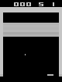
Preprocessing
simply means that our state should not be made up of single frames but instead of the 4 most recent frames.
Since the scale of scores varies greatly from game to game, we fixed all positive rewards to be 1 and all negative rewards to be −1, leaving 0 rewards unchanged. Clipping the rewards in this manner limits the scale of the error derivatives and makes it easier to use the same learning rate across multiple games. At the same time, it could affect the performance of our agent since it cannot differentiate between rewards of different magnitude.
A fully preprocessed state for breakout.

Slide 68
Thank You

